Slide 1

Year 1 Phonics Screening Check Information Evening
Thursday 19th September
Mrs Sinnett
Mrs Burton

Slide 2
We will aim to answer these questions:
What is phonics?
Why is the phonics screen carried out?
What is the phonics screen?
When is the phonics screen?
How can I help my child?

Slide 3

What is phonics?
Phonics is connection between a letter and the sound it makes.
Knowing the connection between a letter (or a group of letters) and the sound, forms a solid foundation for reading.
https://Read Write Inc. Video

Slide 4
What is phonics?
Set 1 - mad
Set 2 - may
Set 3 - make
Set 4 - blue

Slide 5
Why is the phonics screen carried out?
The Phonics Screening Check was introduced by the government in 2012. The idea behind it is to assess how well your child can use the phonics skills they’ve learned up to the end of Year 1, and to identify pupils who need extra support to help them apply their skills.

Slide 6
What is the phonics screening check?
https://Phonics Screening Check Information

Slide 7
What is the phonics screening check?
Consists of 40 words and non-words that your child will be asked to read one-on-one. We will try to make this as fun as possible so the children will not know they are being ‘tested’.
Children will complete practice tests throughout the year. They will become familiar with its format and will and will simply be asked to read with the teacher.

Slide 8
What is the phonics screening check?
It checks that your child can:
Sound out an blend graphemes in order to read simple words.
Read phonically decodable one-syllable and two-syllable words (e.g. cat, sand, windmill)
Read a selection of nonsense words which are sometimes referred to as pseudo words – we call them alien words.

Slide 9
What is the phonics screening check?
Alien words are words that are phonically decodable but are not actual words with an associated meaning e.g. brip, snorb. They are included in the check specifically to assess whether your child can decode a word using phonics skills and not their memory.

Slide 10
When is the phonics screen?
Schools across the country will administer the Year 1 Phonics Screening Check the week beginning:
Monday 9th June 2025
Please ensure your child is at school every day that week.

Slide 11
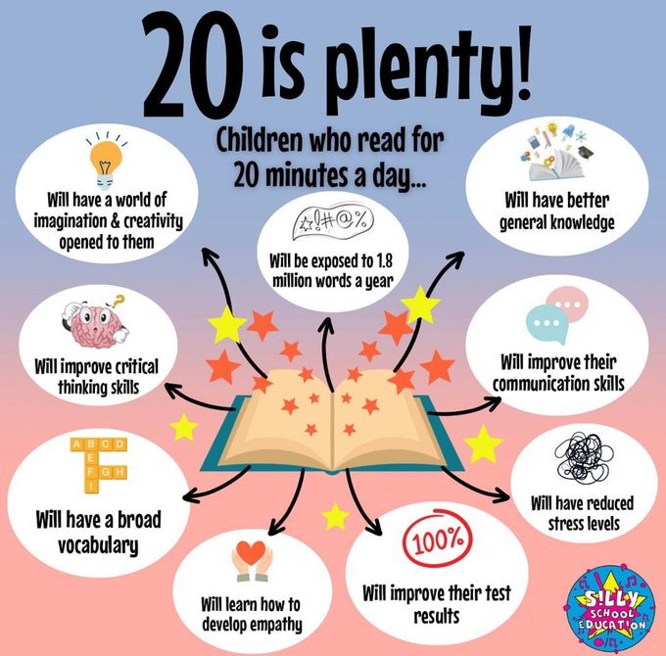
How can I help my child at home?
You can help your child prepare for their Phonics Screening Check by going over the phonics they have learned in Reception and Year 1.
Read with your child ever night.

Slide 12
Useful Websites
https://www.oxfordreadingbuddy.com/uk
There are lots of helpful resources for you and your child. Use your child’s login (in their reading record) to access e-books and quizzes.
https://ictgames.com/phonicsPop/
Phoneme Pop! The sounds and letters drift by on bubbles and your child has to pop the matching sound.
https://ictgames.com/phonicsPop/
Phoneme Pop! The sounds and letters drift by on bubbles and your child has to pop the matching sound.

Slide 13
Useful Websites
https://ictgames.com/mobilePage/literacy.htmlt
There are several free games to play that will help your child with their blending and segmenting.

Slide 14
Support at Home
Playing games such as ‘I Spy’ and ‘Snap’, using
letters and words, will help to make this fun and
mobile too!
Sharing quality reading time with your child, in a comfortable space/ environment will continue to be exceptionally important; being read to and reading with your child will also support them and give you time together to enjoy reading for pleasure.

Slide 15
Any Questions?

Slide 16
Any Questions?
Thank you all very much for coming.

